Slide 1

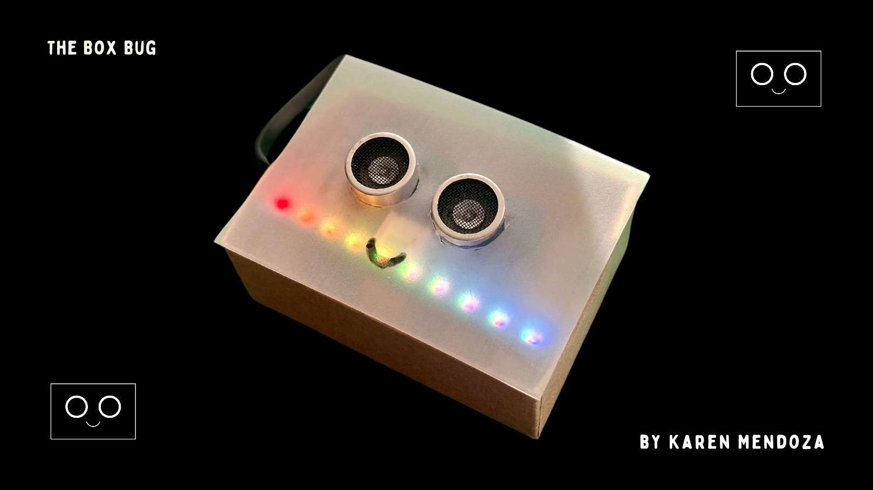
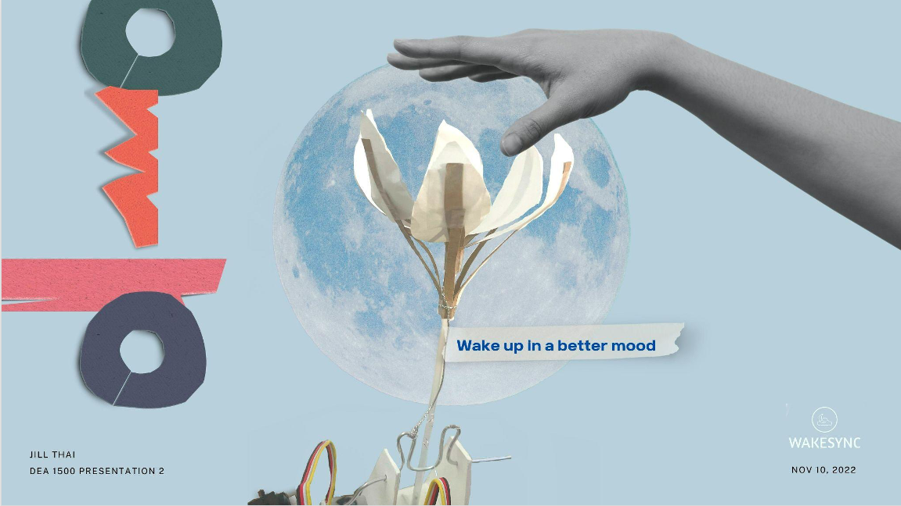
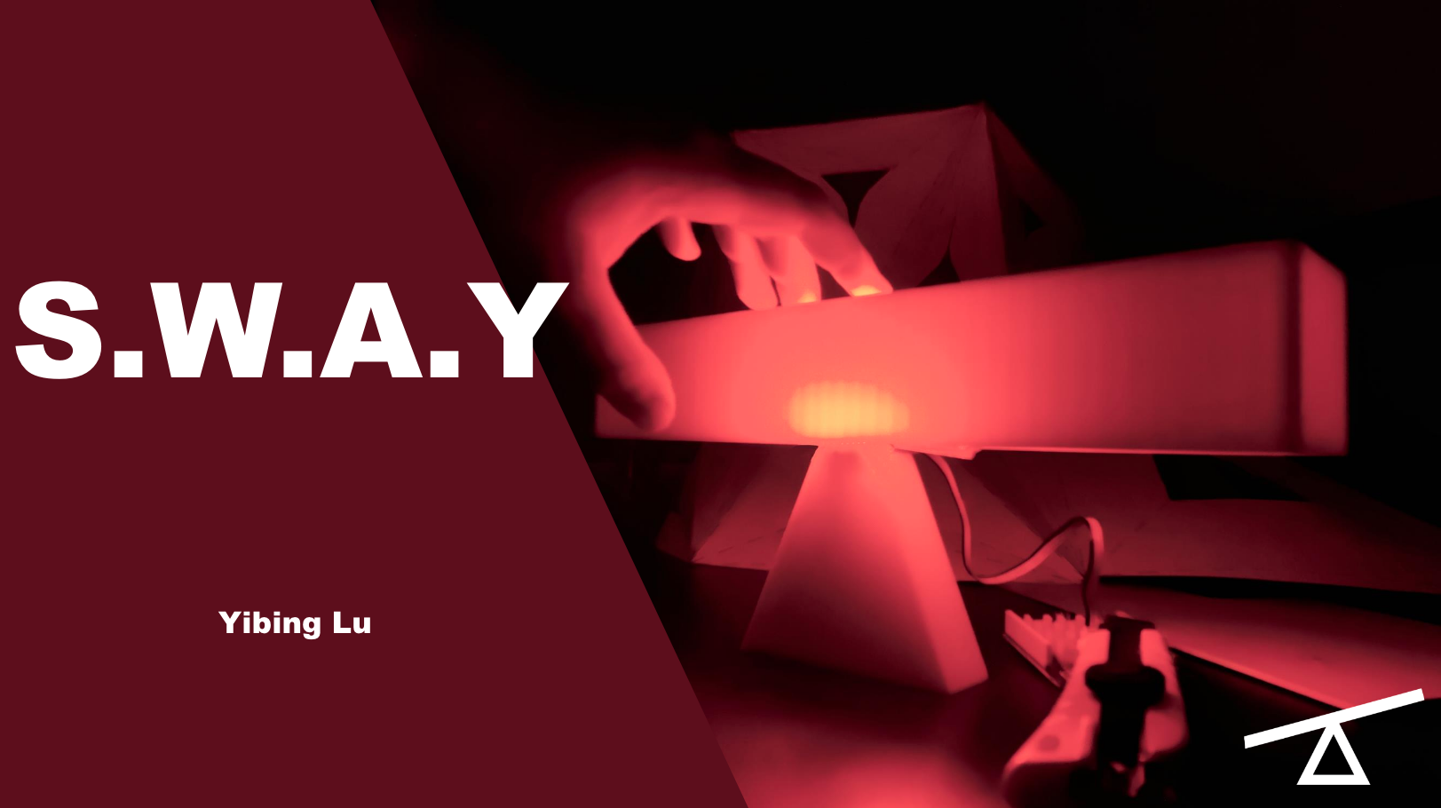
Example cover slide | slide-1
[DESIGN PITCH-1: 5pts]

Slide 2
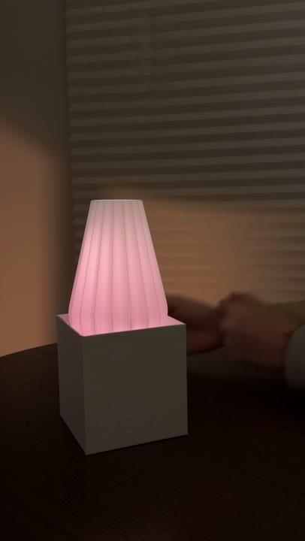
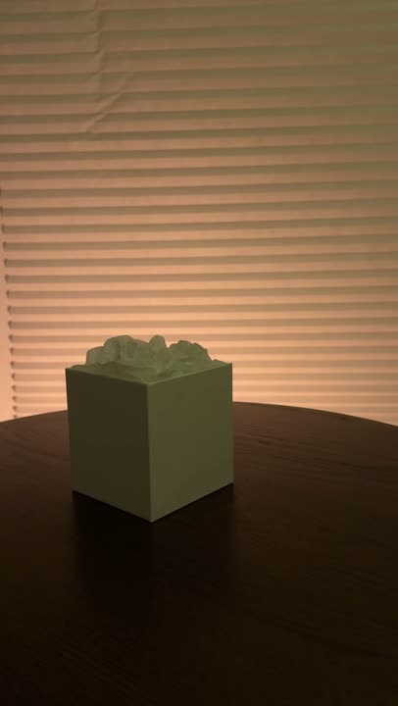
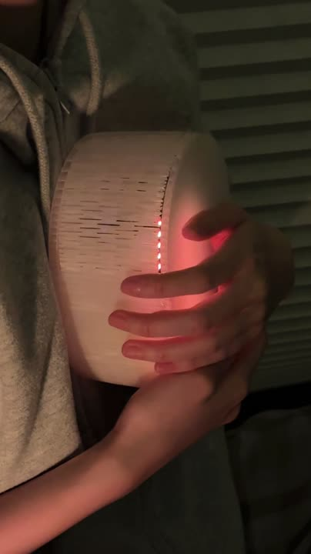
Example 3-videos | slide-2
Prototype 1
Prototype 2
Prototype 3
NearLight
Arueole
Embré
Proximity sensor + LED
Sound sensor + LED
Axis accelerometer + LED
Makes “being near” feel like being with.
A small, authored moment of care
—“I lit this for you”
Regulates stress and communicates
presence through a human rhythm.

Slide 3
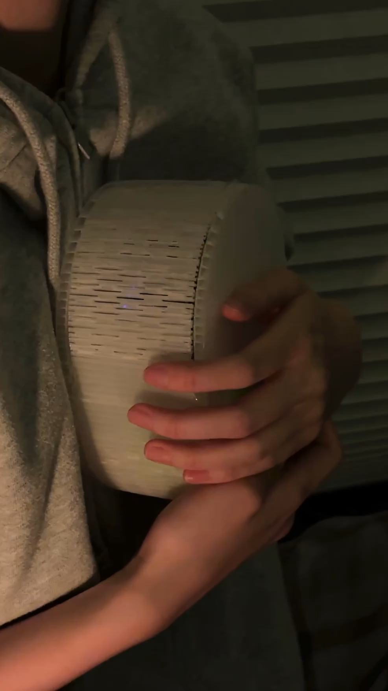
Example best prototype | slide-3
Why choose
Embré?
  Embodied = memorable.
  Directly regulates emotion, not just signals it.
  Guided breathing.
  Co-presence without pressure.

Slide 4
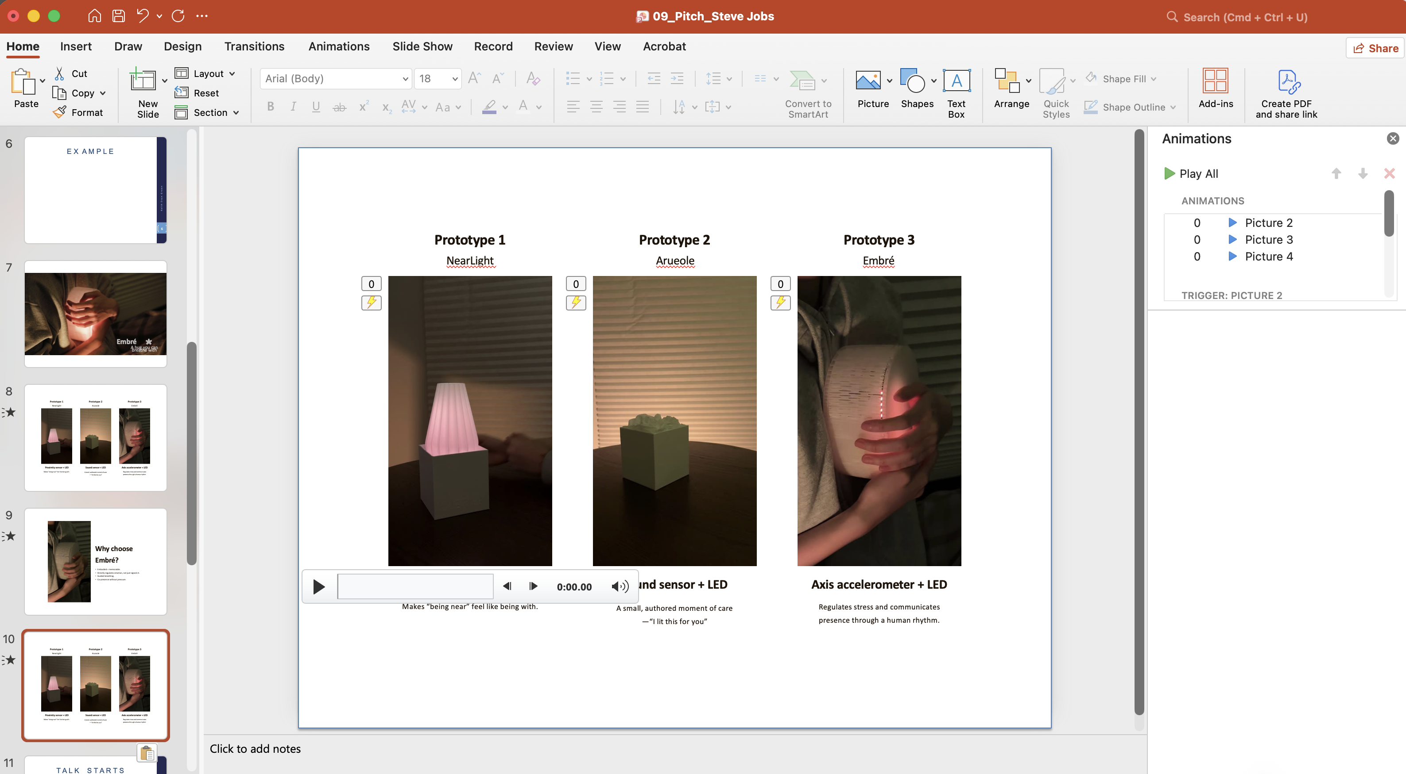
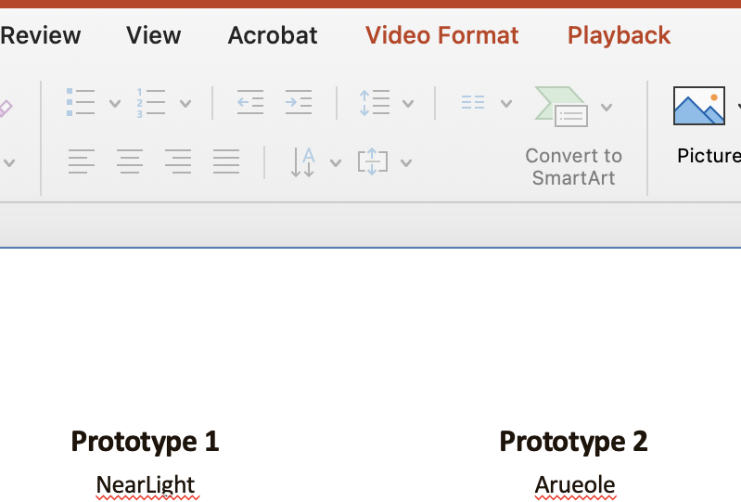
Set all 3 videos to play back and loop automatically.

